Slide 1
Project Sudoku
By PLANQUE Léa & GOIBEAULT Timothée-swann
Polytech Marseille Informatique 3A

Slide 2
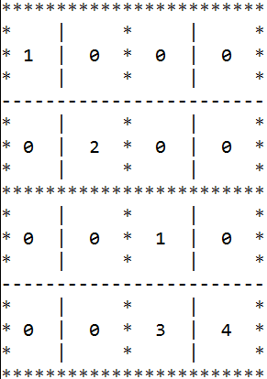
Principle
Numbers:1->4
Same 2 numbers by line,clomun and bloc
Only one solution

Slide 3
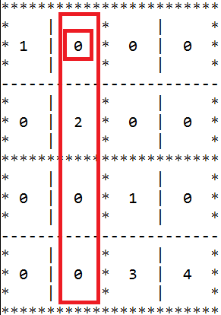
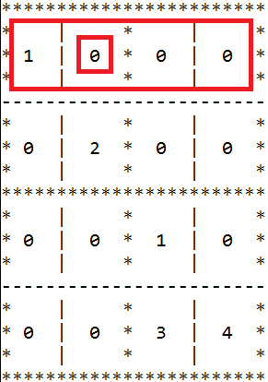
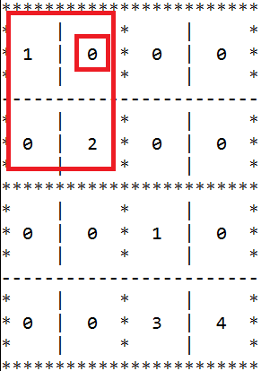
Fill possibilities cell by cell
Columns
Lines
Blocs

Slide 4
Back track
Less possibilities
Choose one
repeat while we find cell with possibilities
If we have no possibilities and the sudoku is not finish return to the false choice and change it

Slide 5
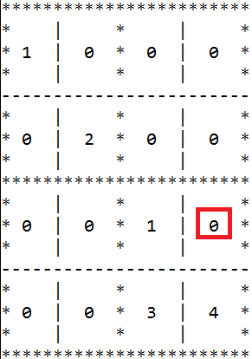
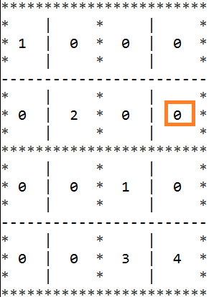
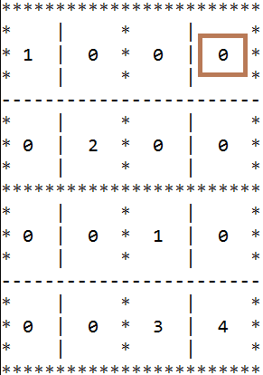
Optimisation
2
3,1
2,3

Slide 6
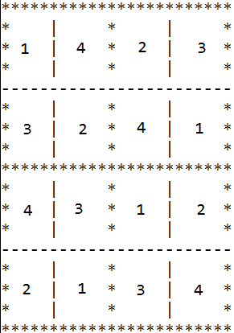
Conclusion
Possibilities
Try until find the good one
More optimisation
Thank you for your attention

